Slide 1
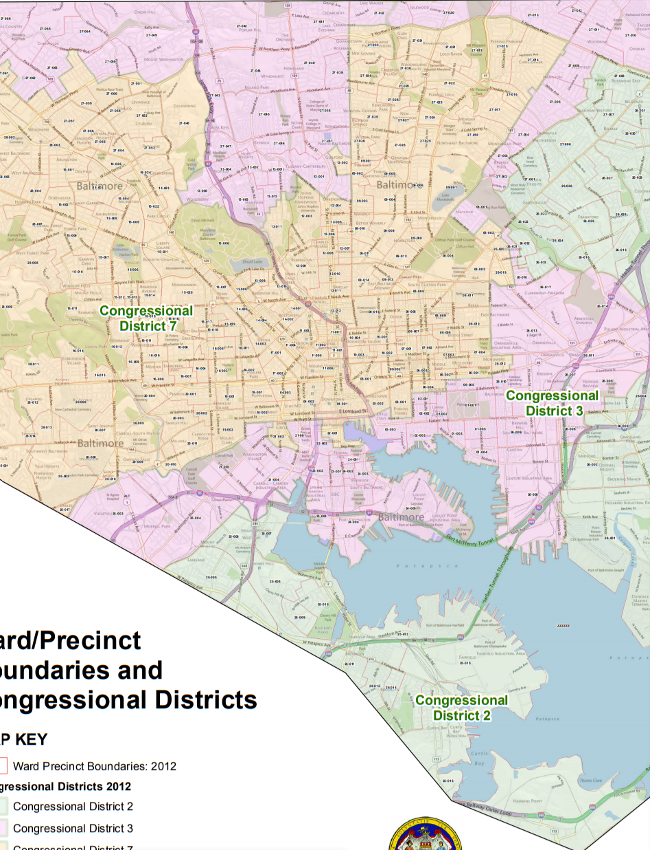
Cluster Analysis of Baltimore Election Precincts (2016)
By: Clayton McLane
What Election Precincts in Baltimore exhibit similar party voting behavior in major political races?

Slide 2
Clusters
Blue: Average Size, Very Democratic
Red: Large, Very Republican, and Very libertarian
Black: Small, Very Libertarian
Green: Large, Slightly Democratic, and Very Green
Yellow: Very Small, Very Democratic

Slide 3
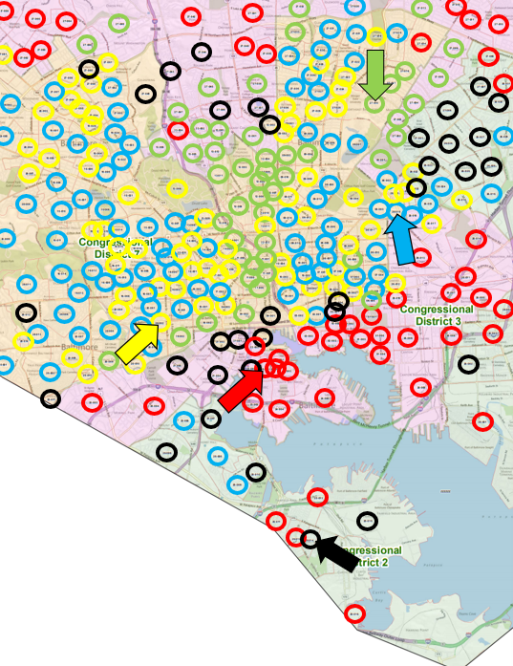
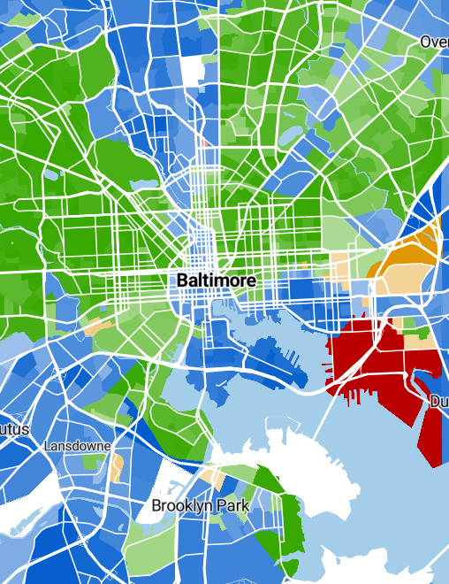

Slide 4
